Slide 1
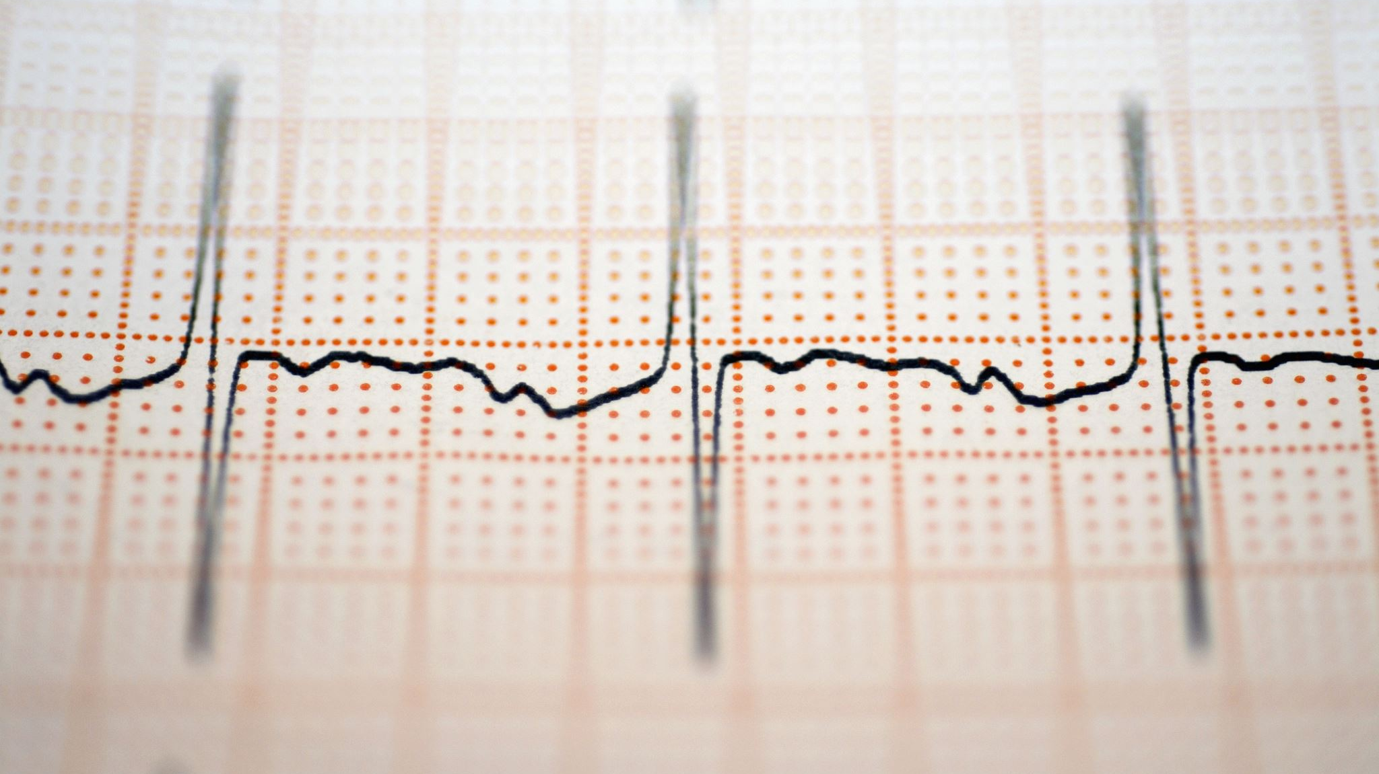

2-day Workshop EEG

Slide 2
Program session5&6
Baseline / Detrend correction
Re-referencing
Trial rejection
Time extraction & plot
Time-frequency extraction & plot

Slide 3
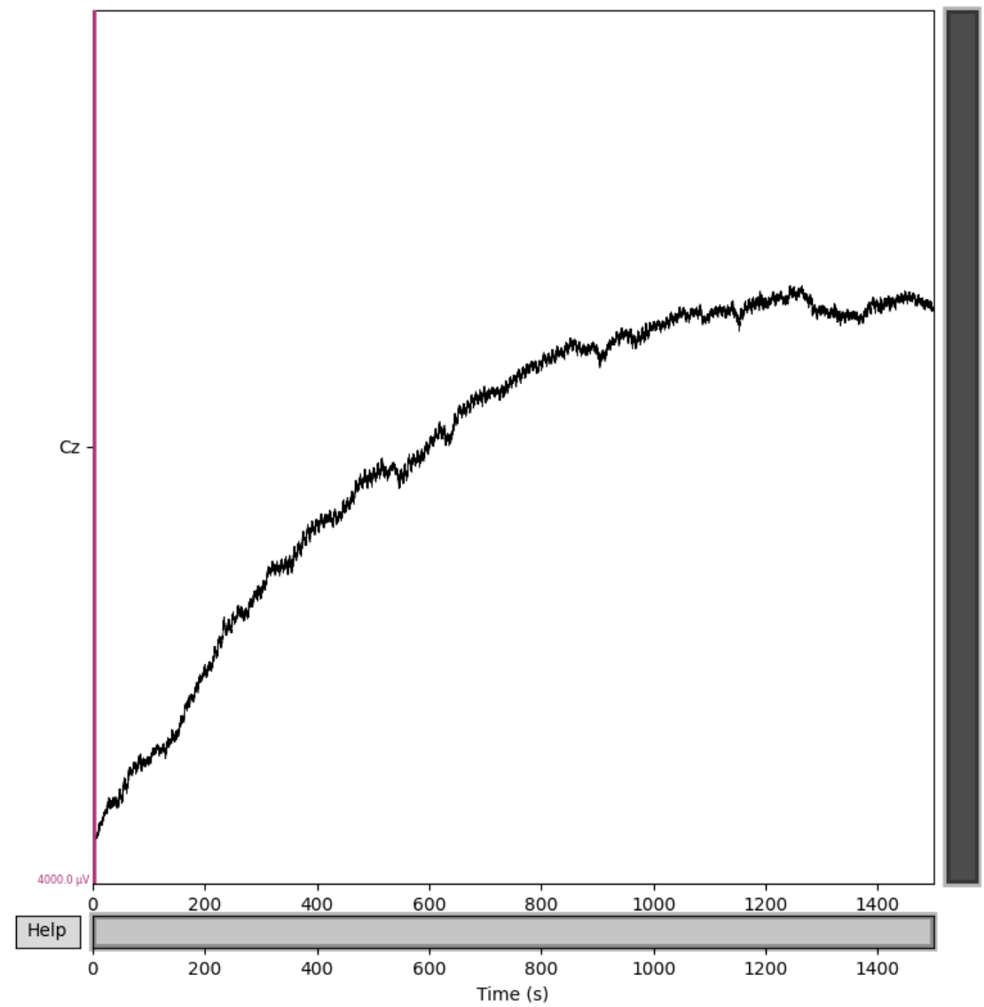
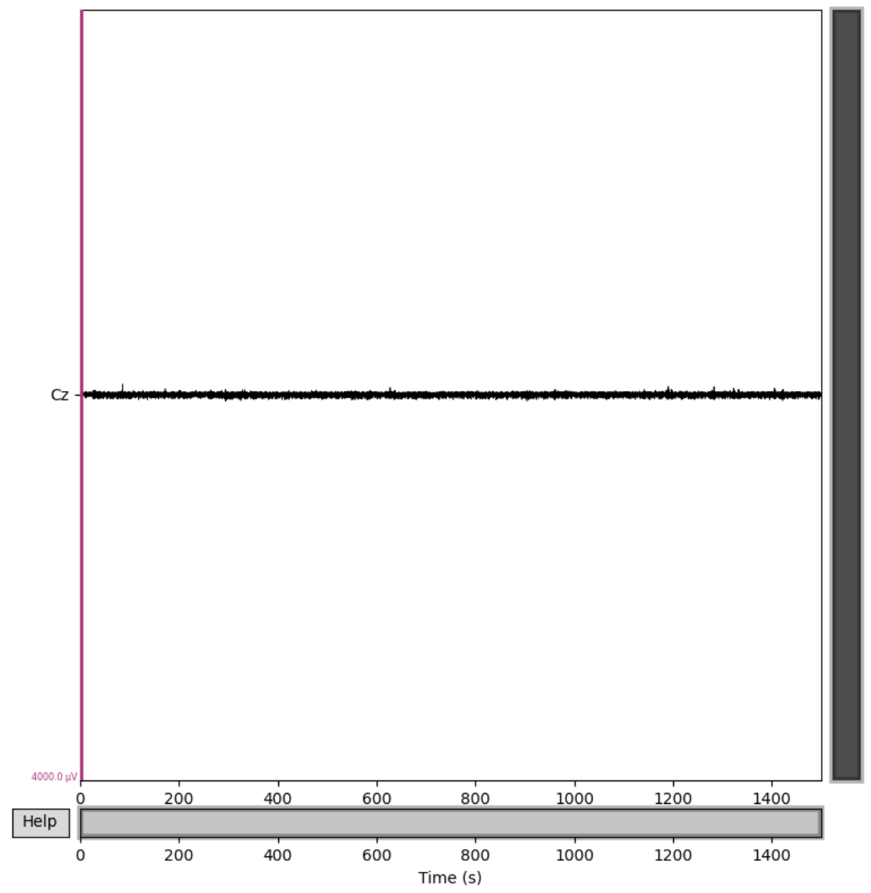
Baseline
why?

Slide 4
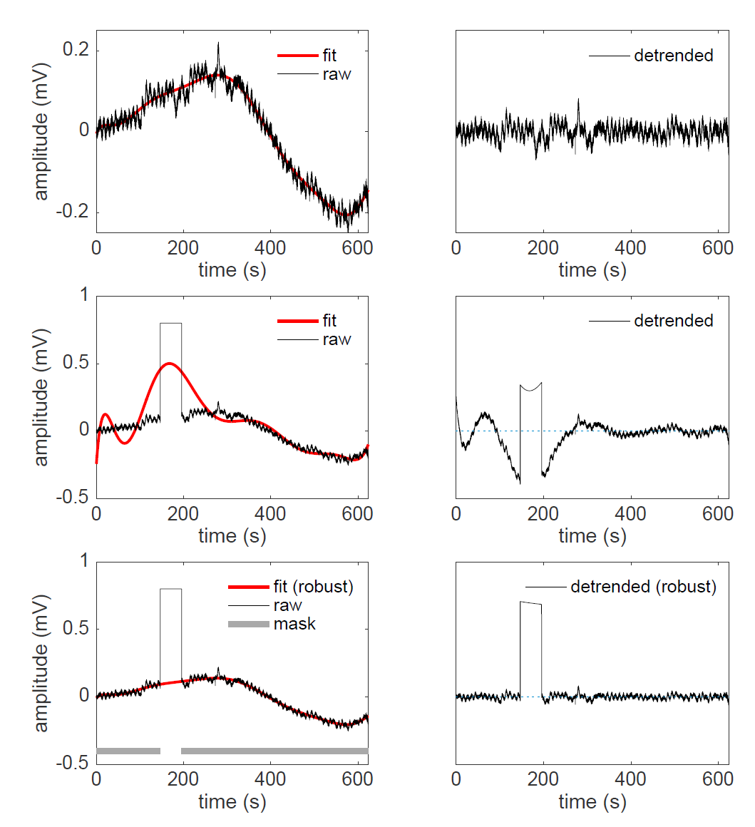
Baseline
why?
Cheveigné & Arnouzian (2018) Neuroimage

Slide 5
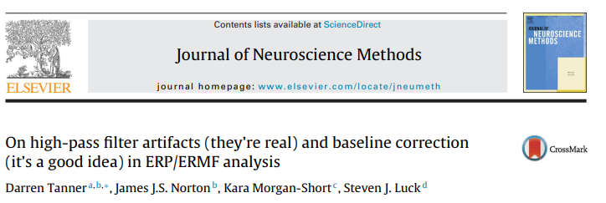

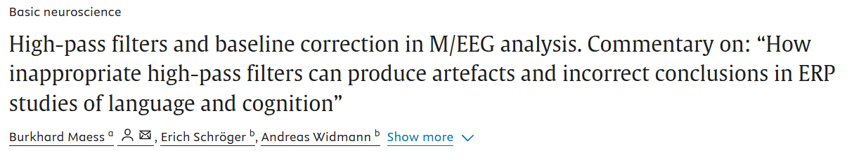
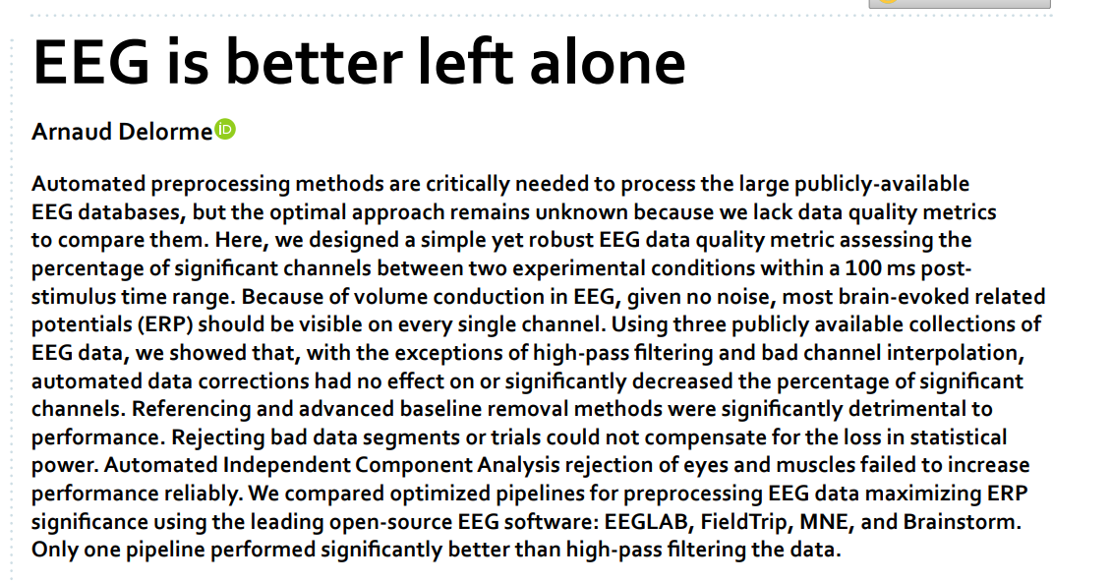

Baseline
why?

Slide 6
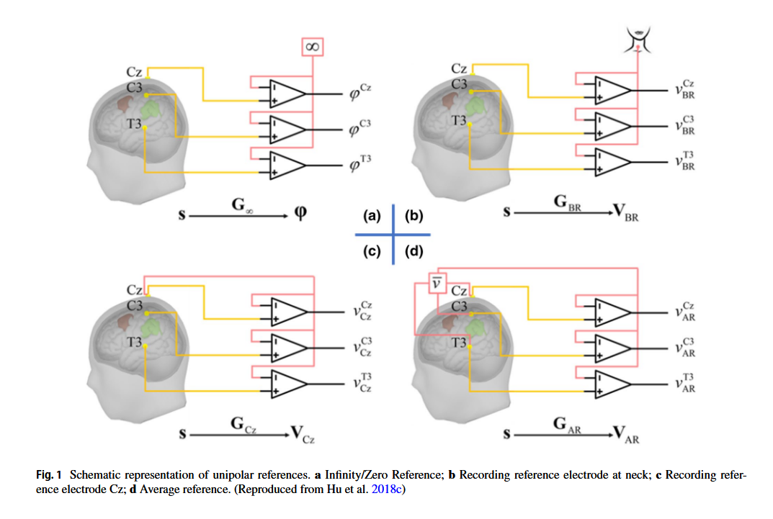
Baseline
why?
Reference
Which?
Yao et al., (2019) Brain Topography

Slide 7
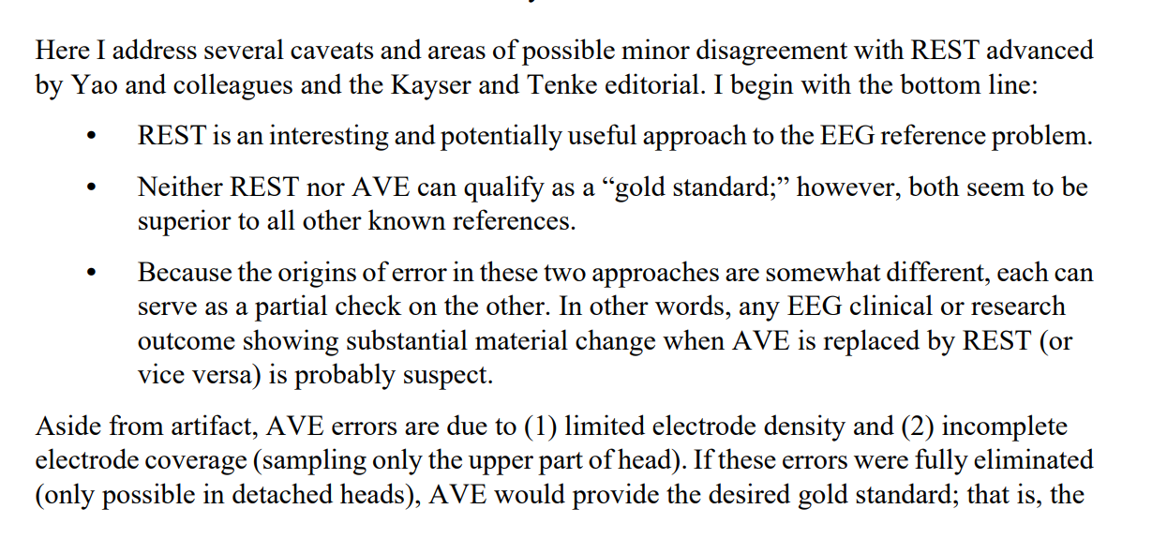
Baseline
why?
Reference
Which?
Nunez (2010) Clin. Neurophysiology

Slide 8
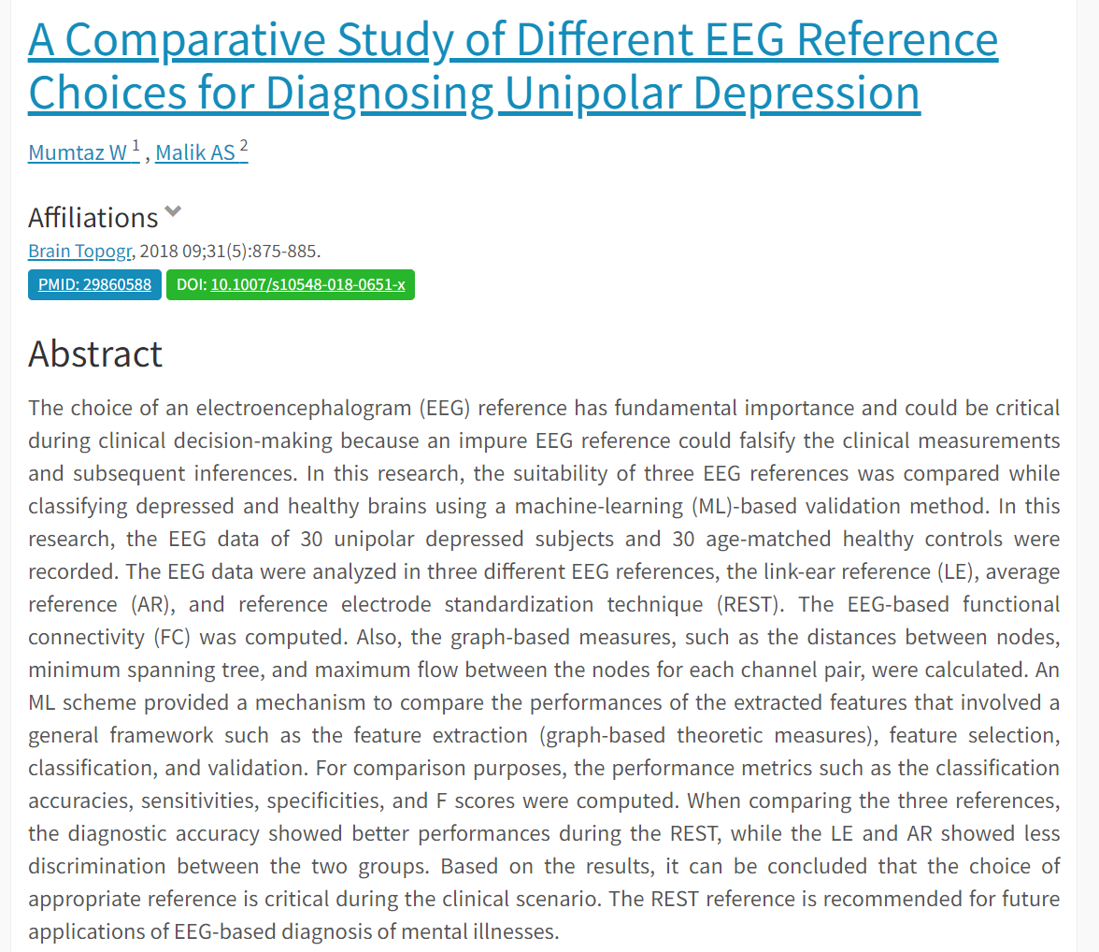
Baseline
why?
Reference
Which?

Slide 9
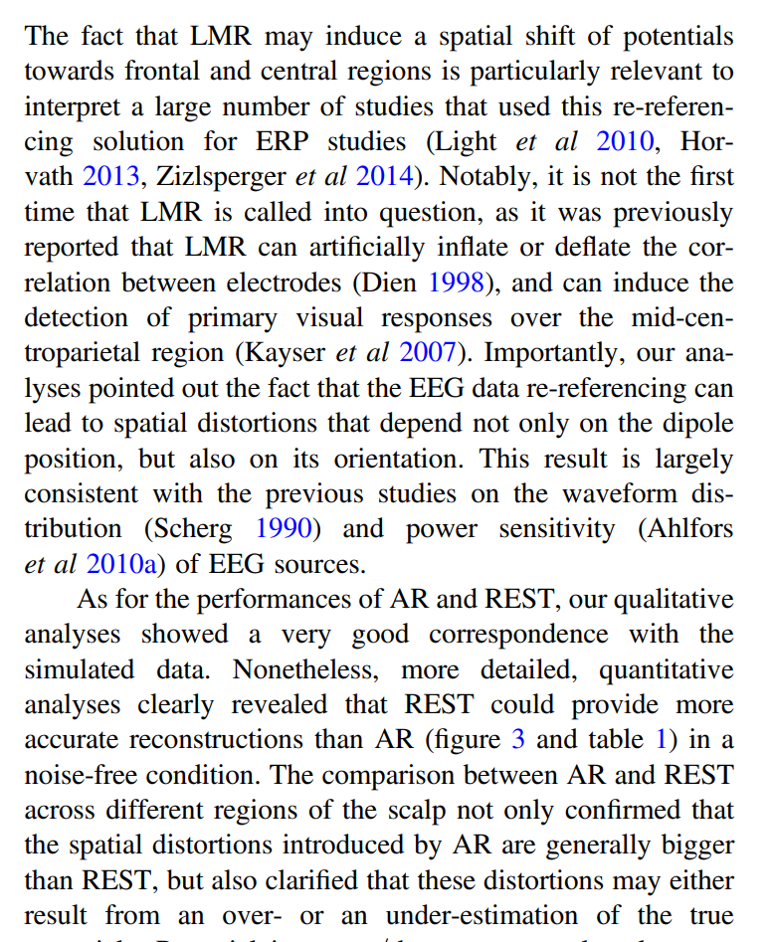
Baseline
why?
Reference
Which?
LMR = mastoids
Liu et al., (2015) Journal of Neural Engineering

Slide 10
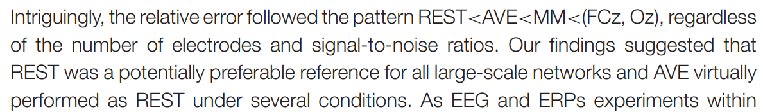
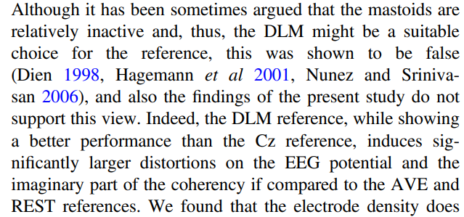
Baseline
why?
Reference
Which?
MM = mastoids
Lei et al., (2017) Frontiers in Neuroscience
DLM = mastoids
Chella et al., (2016) Journal of Neural Engineering

Slide 11
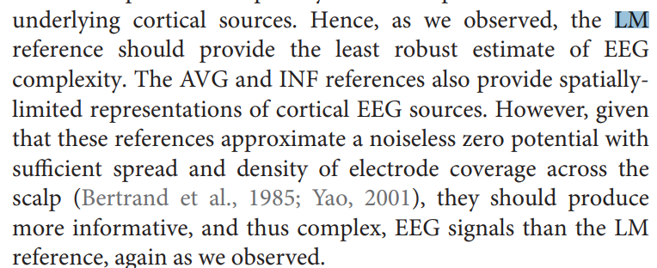
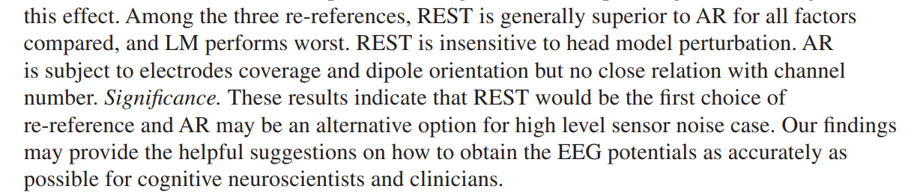
Baseline
why?
Reference
Which?
LM = mastoids
Trujillo et al., (2017) Frontiers in Neuroscience
Hu et al., (2018) Journal of Neural Engineering

Slide 12
Baseline
why?
Reference
Which?
Yao et al., (2019) Brain Topography

Slide 13
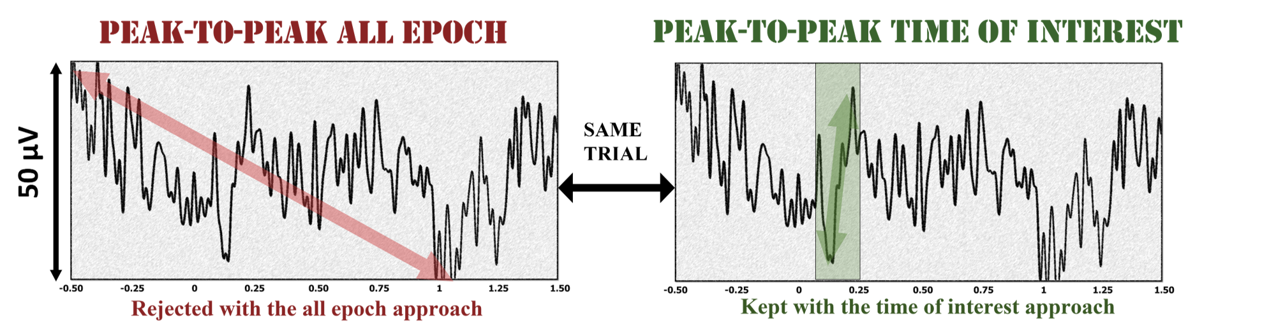
Baseline
why?
Reference
Which?
Trial rejection
How?
Removing artifacts at the epoch stage is one of the many problems that researchers face when using EEG. The literature varies from manual visual rejection to subjective or automatic thresholds rejection based on peak-to-peak amplitude ^{1,2,3}.
I propose to focus only on the time of interest to automatically detect artifacts, as there is no justification to remove artifacts that precede or follow the event of interest.
¹ Tatum, W. O., Dworetzky, B. A., & Schomer, D. L. (2011). Artifact and Recording Concepts in EEG. Journal of Clinical Neurophysiology, 28(3), 252.
² Peng, W. (2019). EEG Preprocessing and Denoising. In L. Hu & Z. Zhang (Eds.), EEG Signal Processing and Feature Extraction (pp. 71–87). Springer.
³ Jas, M., Engemann, D. A., Bekhti, Y., Raimondo, F., & Gramfort, A. (2017). Autoreject: Automated artifact rejection for MEG and EEG data. NeuroImage,

Slide 14
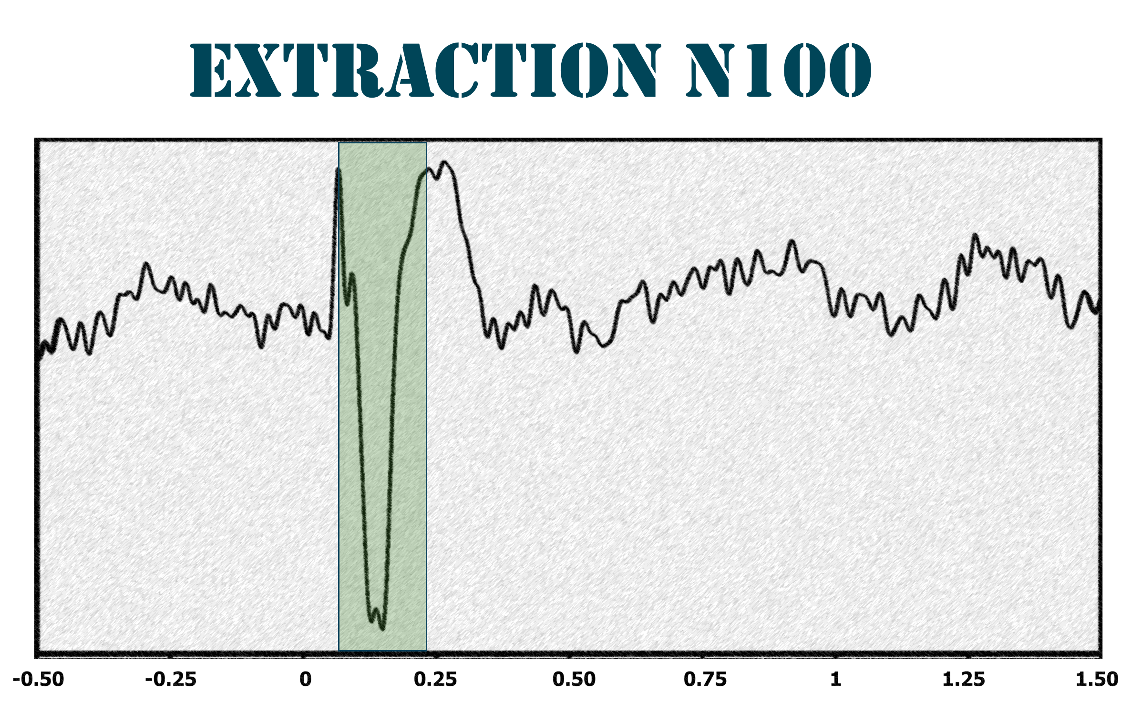
Baseline
why?
Reference
Which?
Trial rejection
How?
Removing artifacts at the epoch stage is one of the many problems that researchers face when using EEG. The literature varies from manual visual rejection to subjective or automatic thresholds rejection based on peak-to-peak amplitude ^{1,2,3}.
I propose to focus only on the time of interest to automatically detect artifacts, as there is no justification to remove artifacts that precede or follow the event of interest. Moreover, instead of solely focusing on the peak-to-peak value, both the mean and the slope should also be considered in detecting these outliers, as they capture features of the signal.
The idea is to first generate the average plot to define a time window of interest, and then remove artifacts depending on our criteria (manual or automatic threshold)
Moreover, instead of solely focusing on the peak-to-peak value, both the mean and the slope should also be considered in detecting these outliers, as they capture features of the signal.
¹ Tatum, W. O., Dworetzky, B. A., & Schomer, D. L. (2011). Artifact and Recording Concepts in EEG. Journal of Clinical Neurophysiology, 28(3), 252.
² Peng, W. (2019). EEG Preprocessing and Denoising. In L. Hu & Z. Zhang (Eds.), EEG Signal Processing and Feature Extraction (pp. 71–87). Springer.
³ Jas, M., Engemann, D. A., Bekhti, Y., Raimondo, F., & Gramfort, A. (2017). Autoreject: Automated artifact rejection for MEG and EEG data. NeuroImage,

Slide 15
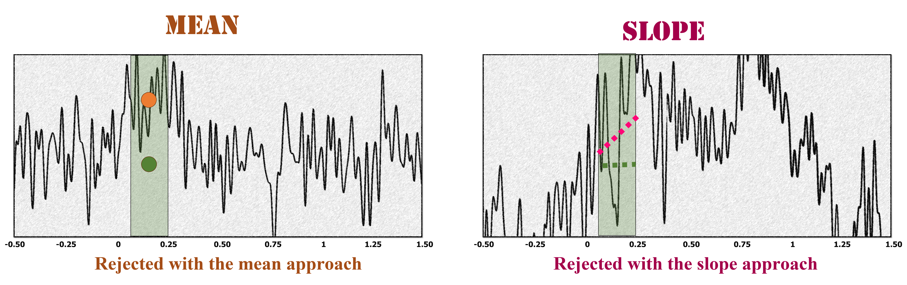
Baseline
why?
Reference
Which?
Trial rejection
How?
Interestingly, we can observe that some artifact trials, likely caused by head movements, might be considered valid based on the peak-to-peak value but still interfere with the ERP of interest. Using the mean and slope as features could help in detecting these artifacts. On the left, the green dot represents the mean of the ERP without artifacts, and this trial would be considered an outlier because its mean (orange dot) is significantly distant from the green dot. Similarly, in the right plot, the slope should be nearly flat for the N100 (green line), but the artifact produces a steep slope (pink line) that can be detected.

Slide 16
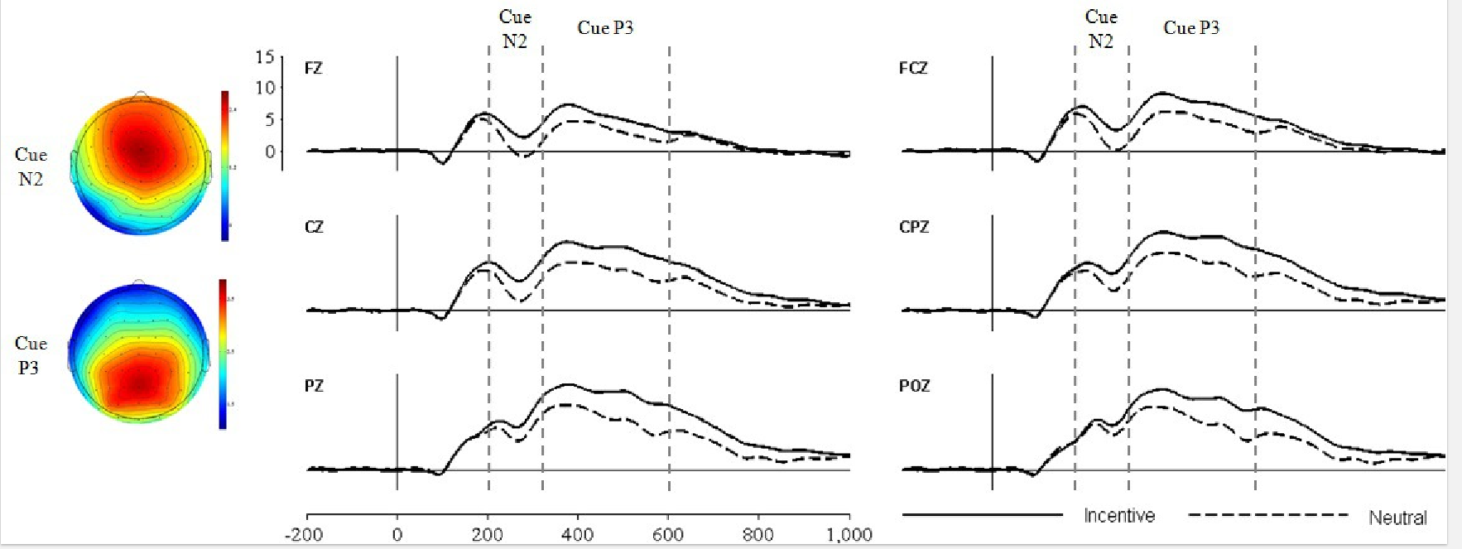
Baseline
why?
Reference
Which?
Trial rejection
How?
Time Domain
Extraction & Plots
Glazer et al., (2018) International Journal of Psychophysiology

Slide 17
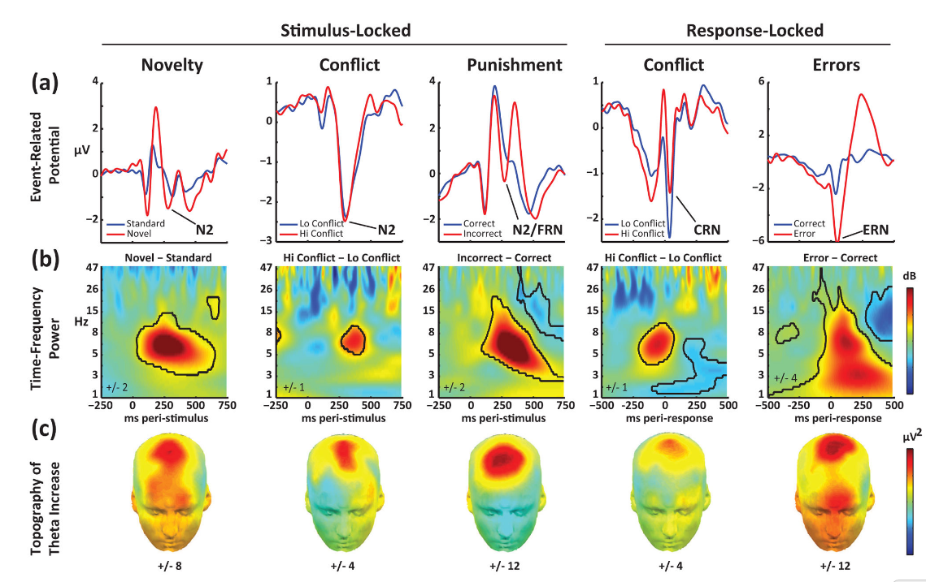
Baseline
why?
Reference
Which?
Trial rejection
How?
Time Domain
Extraction & Plots
Time-Frequency
Extraction & Plots
Cavanagh & Frank (2014) TICS

